Slide 1
SAFE COMMUNICATION OVER
UNSAFE CONNECTIONS
NAME: REETIKA GAUTAM
ROLL_NO: 10900215059

Slide 2
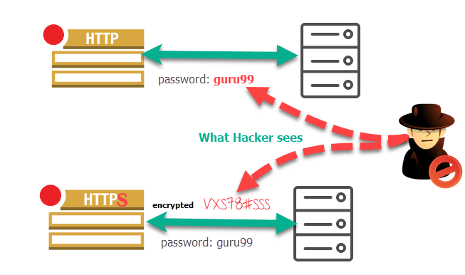
Let us know why HTTPS is preferred over HTTP ??

Slide 3
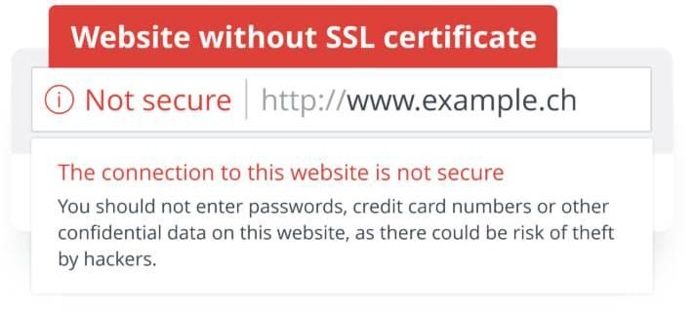
As we know that http sends data in plain text from browser to the server through any public network where our data is not at all secure and can be monitored at any given point.

Slide 4

SOLUTION PROPOSED:
I came up with a solution to this where i am encrypting the data through by any random key using Caesar Cypher method, while the message is being sent from the browser and decrypting the data at receiver’s end using NLP . you can call it a self made https server where i use http + encryption technique to secure my credentials without SSL.

Slide 5
NLP using NLTK
NLTK is a platform used for building python programs that work with human language data for applying in statistical natural language processing(NLP).
It contains text processing libraries for tokenization ,parsing,classification,stemming,tagging and semantic reasons.
In my algorithm i’ve used nltk.corpus , corpus is a package which has a predefined collection of words. From nltk.corpus we import words which has a list on all possible meaningful words till date.

Slide 6
CHALLENGE :
The biggest challenge which i faced while working on this project is that i had to fetch data from php to python to process it while decryption using NLP. To my rescue came one such website called pythonanywhere.com where you can code and deploy all your notebook files also web applications of python, it has its free hosting ready . but how to fetch the data,?? we know that when we use get method our data is submitted via link to the server so what we could do was pass the encrypted message through link to pythonanywhere.com where it can retrieve data from its link and process it.It made things simpler and life easier and the message , SAFER.

Slide 7
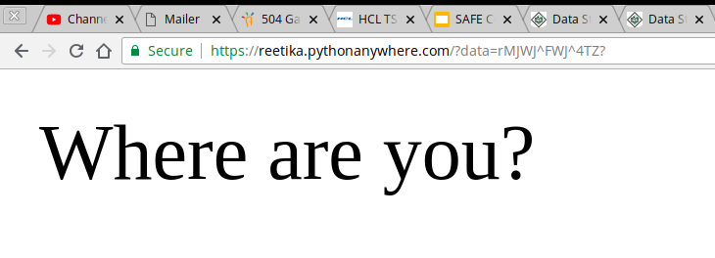
Use of Python Anywhere

Slide 8
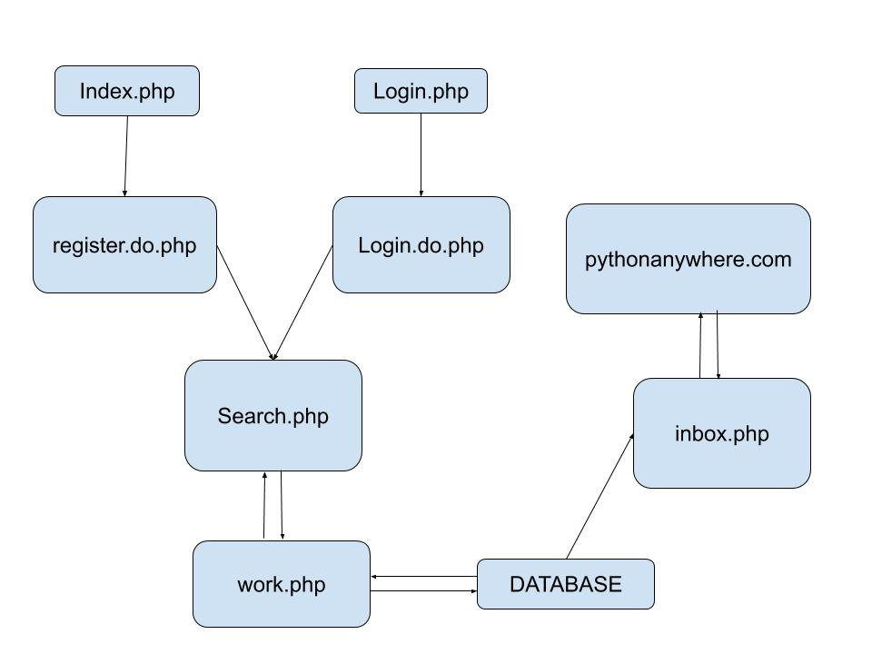
DATA FLOW DIAGRAM OF WHOLE MAILING SYSTEM:

Slide 9
USE CASES OF MY PROJECT
Most registered websites are still http:// enabled which is quite risky while you deal with sessioned applications , as your data is vulnerable to packet sniffing and monitoring because the data exchanged is in plain text in http.My application is a solution to all these problems.
We can get a secure website if we buy SSL for our websites (http+SSL=https) but wait, look for the heavy cost they charge you for keeping your data safe while it gets transferred through public network.what i did was, made my own SSL free of cost.

Slide 10
REFERENCES:
https://www.geeksforgeeks.org/whats-difference-http-https/[to get the detailed information of http and https]
https://www.pythonanywhere.com/user/mayankgbrc/[to host the web page made in flask ]
https://www.w3schools.com/php/default.asp[resolve problems encountered while working with php]
https://www.tutorialrepublic.com/php-tutorial/php-mysql-ajax-live-search.php[to copy code for working of ajax]
https://www.fullstackpython.com/flask.html[beginning with flask].

Slide 11
THANKYOU!!!

